Slide 1



Slide 2

E Tendering and Monitoring
Supervised by:
Mam Sadia Ejaz
Group Members:
Saif Muzaffar ( FA17-BCS-102 )
Muhammad Bilal ( FA17-BCS-080 )
Presented on
(Cs Department) COMSATS University Islamabad
Attock Campus

Slide 3
Outline
Introduction
Problem statement
Objectives
Methodology
Functional requirements
Existing apps
Tools and technology
Benefits
Diagrams
System screenshots
References

Slide 4
Introduction
An e -Tendering System facilitates the complete tendering process from the advertising of the requirement through to the placing of the contract. This includes the exchange of all relevant documents in electronic format.
E Tendering is a process of carrying out entire Tendering Cycle Online including submission of Price Bid such that Efficiency, Economy, Speed of Internet can be harnessed.

Slide 5
Problem Statement
Longer Procurement Cycle Expensive
No work on Holidays
Prone to Human errors
Content not sharable Physical Security
Wastage of space to store bids Not retrievable

Slide 6
Objectives
The main aims and objectives of our system are as under :-
To provide ease to contractors.
To make the register work digitally.
To bid online through app instead of Paper.
To provide peaceful process to contractors and to office boys.
To make paper work as less as possible.
To change the traditional paper work digitally

Slide 7
Methodology
PREPARATION OF BIDS
Bidder should take into account any corrigendum published on the tender document before submitting their bids.
Please go through the tender advertisement and the tender document carefully to understand the documents required to be submitted as part of the bid.
SUBMISSION OF BIDS
Bidder should log into the app well in advance for bid submission so that he/she upload the bid in time, i.e. on or before the bid submission time. Bidder will be responsible for any delay due to other issues.
The bidder has to digitally sign and upload the required bid documents one by one as indicated in the tender document.
Rate Filling
After the submission of bid the contractor will fill the rates according to the rates given in bid per-item. Each and every item in the given bid have a different rate.
The rates will be according to the given rates by the department in the bid.

Slide 8
Methodology
Rate calculation
When the rates had been filled in the given bid and the bid had been submitted , the rates will be calculated automatically .
The tender will be issued to the company which fill the lowest rates per-item.
Notification of issued tender
When the lowest coat has been calculated the notification “Congratulations The Tender has been issued to your company” will goes to the company which filled the lowest rates in the bidding section
On the other hand which companies had not fill the lowest rate in the bidding section then they get notification “Sorry, Better luck next time”.

Slide 9
Functional requirements
Login
User registration
Logout
View Tender
Bidding
Notifications
Billing
Monitoring

Slide 10
Existing apps
Company | Difficult UI | Bid-sheet-filling (ONLINE) | Application Notification | PUNJAB (PHE)
E-tendering (NHA) | YES | NO | NO | NO
E-tendering (ours) | NO | YES | YES | YES

Slide 11
Tools and Technologies
Android Studio and SDK (Designing and Development)
Star UML (for designing Diagrams)
Database Firebase
Java Programming language (Building block for Android Programming

Slide 12
Benefits
Completely Automated Process
Shortens Procurement Cycle
Economical and Environment Friendly
Greater Transparency
Improvement in work culture in the departments
System aided Evaluation process
On the fly reports/comparatives statement
Minimize Human errors
Minimal Storage Spaces
Change in Perception – Progressive Organization
Lesser hassle of communication and administration

Slide 13
Diagrams
Use Case Diagrams
Admin Use Case Diagram
Activity Diagrams
Admin Activity Diagram
DFD Diagrams
DFD Level 1
DFD Level 2

Slide 14
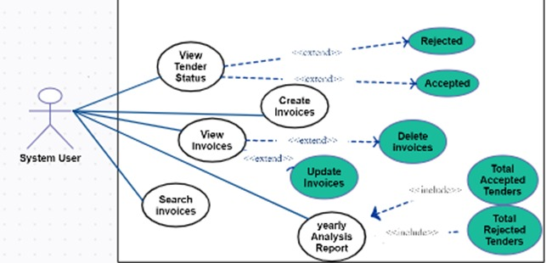
Use case Diagram

Slide 15
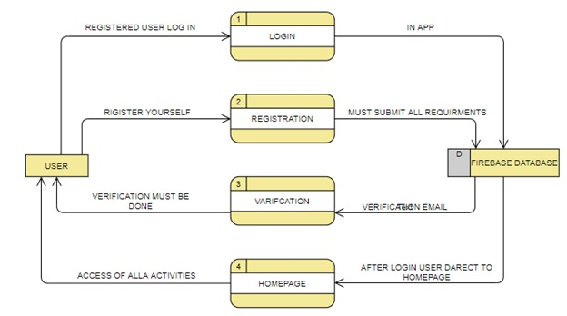
DFD Diagram Level 1

Slide 16
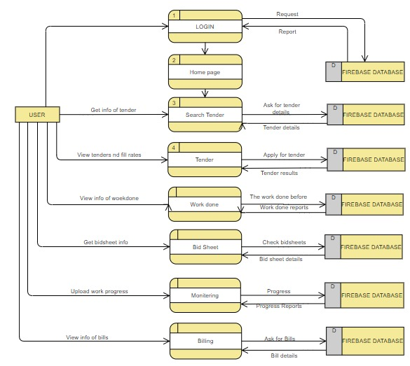
DFD Level 2

Slide 17
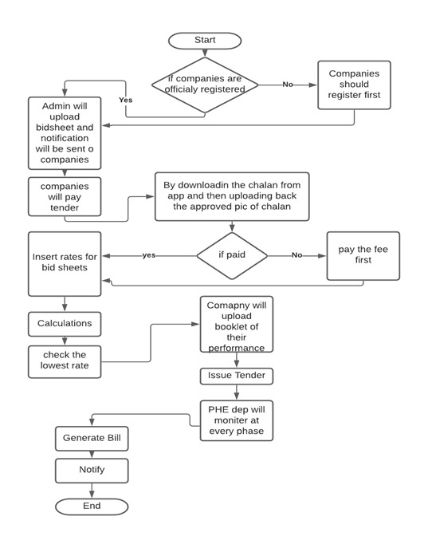
Activity Diagram

Slide 18
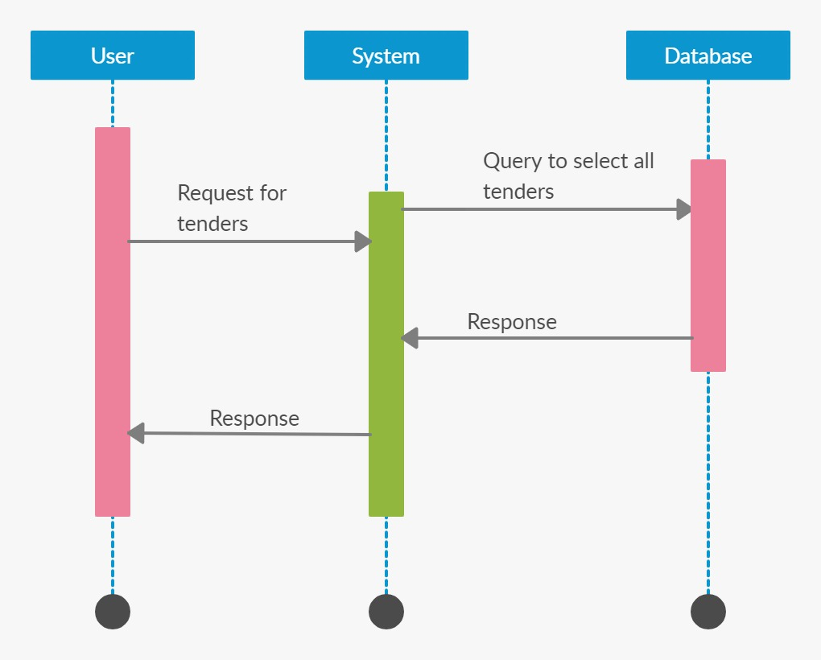
Sequence Diagram For Tender

Slide 19
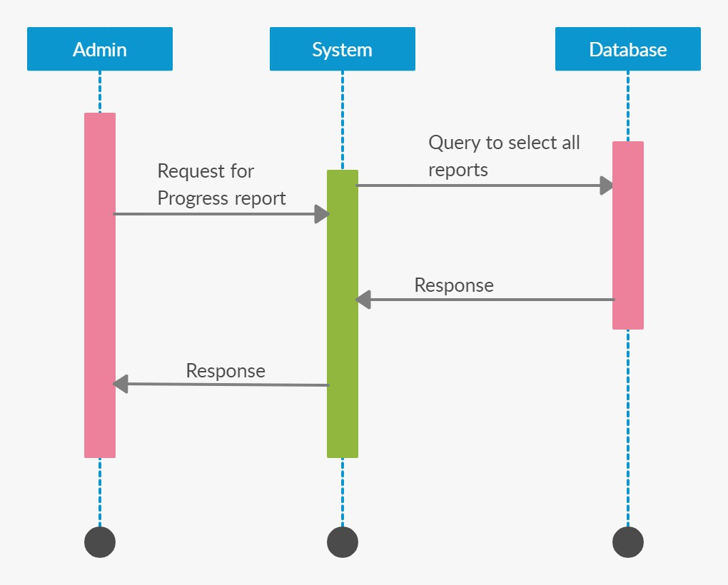
Sequence Diagram Monitoring

Slide 20
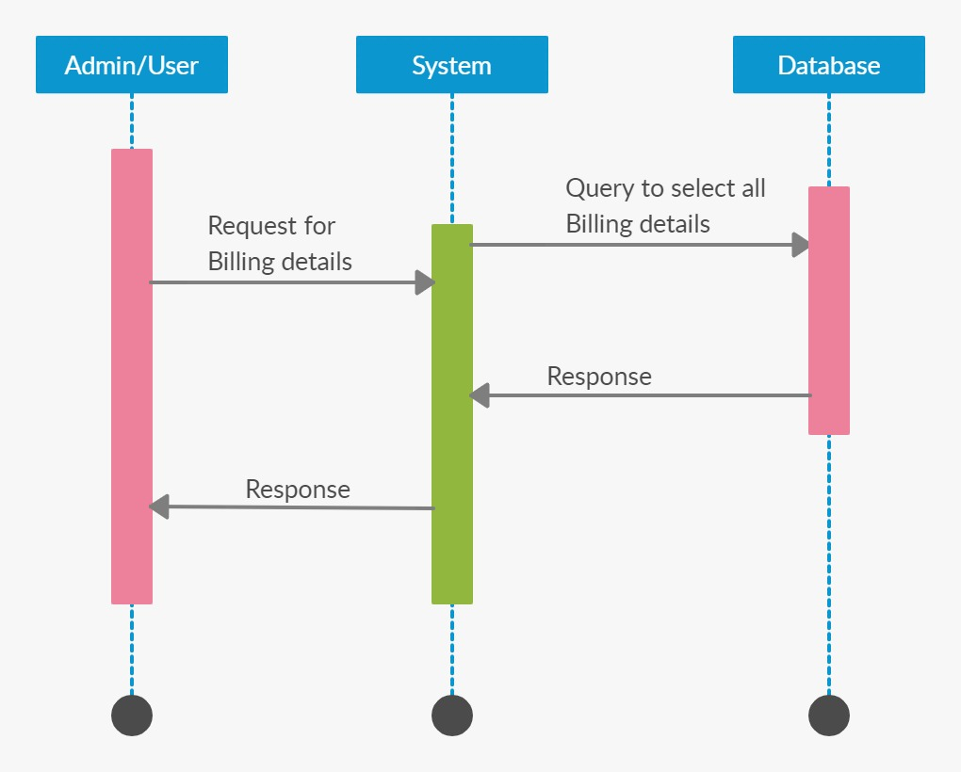
Sequence Diagram Billing

Slide 21

Sequence Diagram Bidding

Slide 22

Splash screen

Slide 23
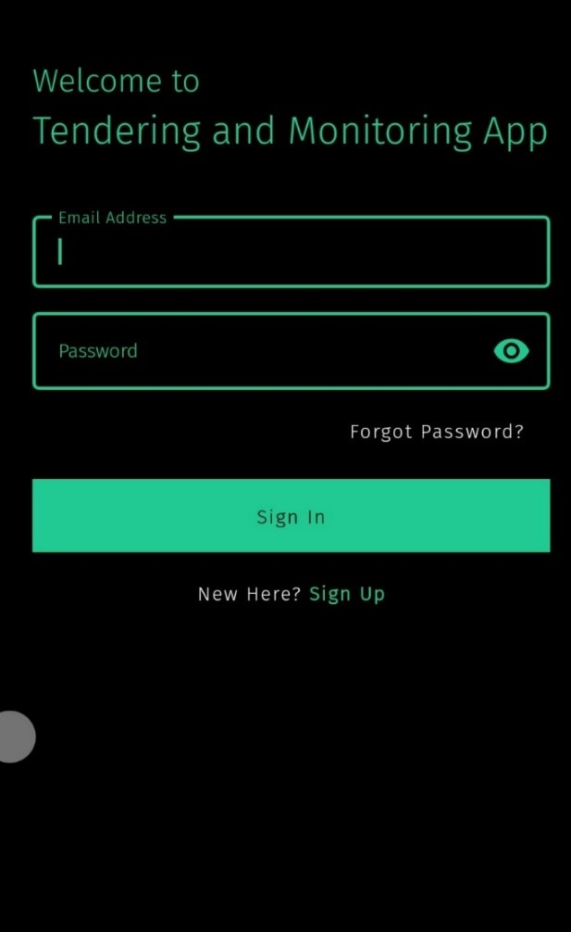
Login Page

Slide 24
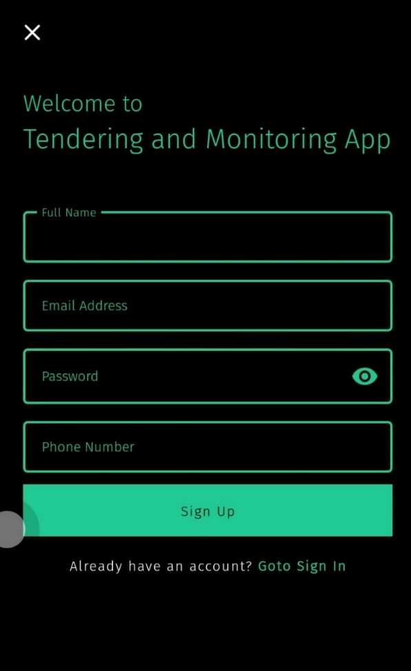
User registration

Slide 25
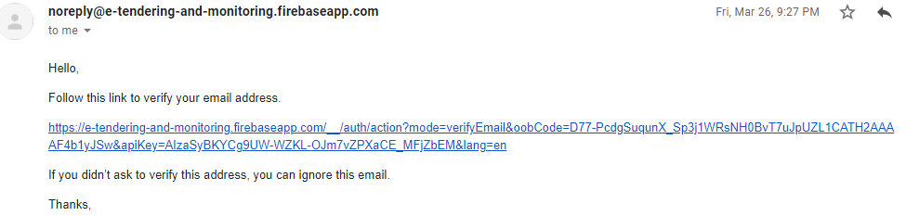
Email Verification

Slide 26
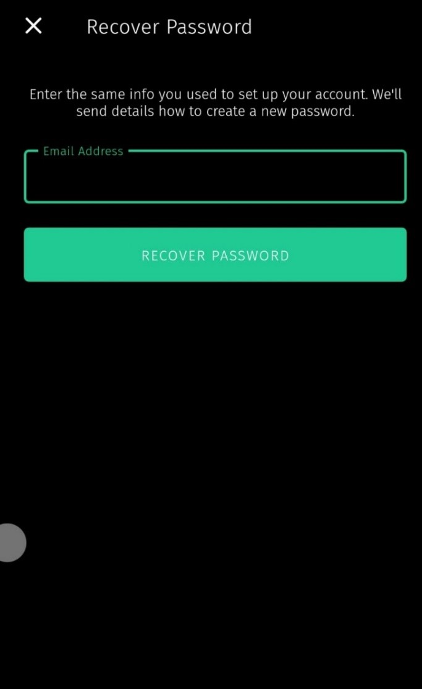
Forget Password

Slide 27
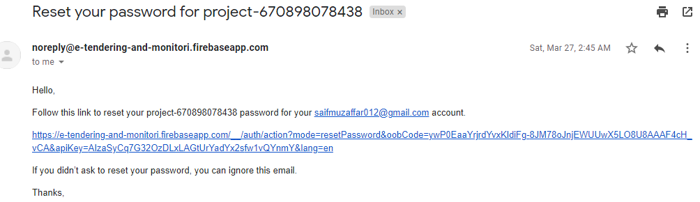
Reset Password email

Slide 28
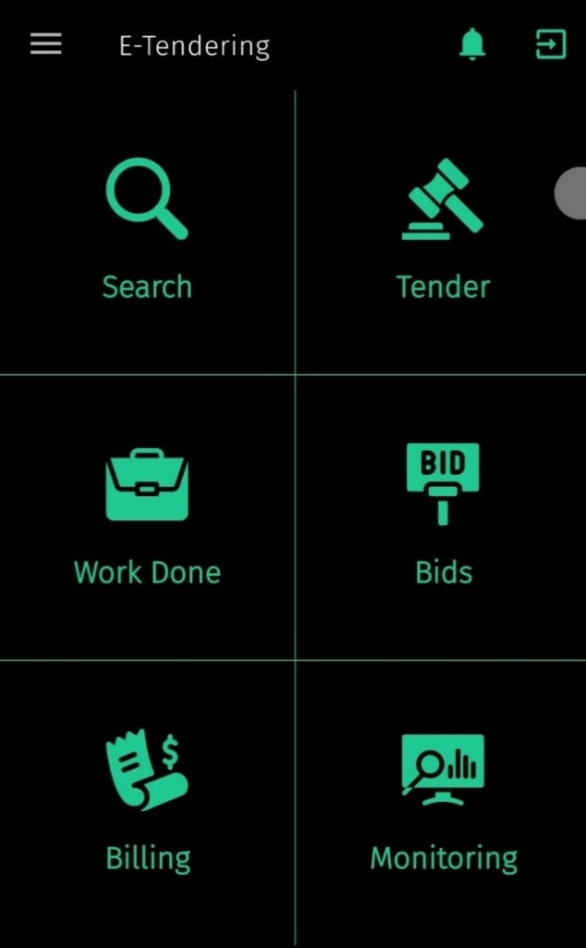
Dashboard Screen

Slide 29
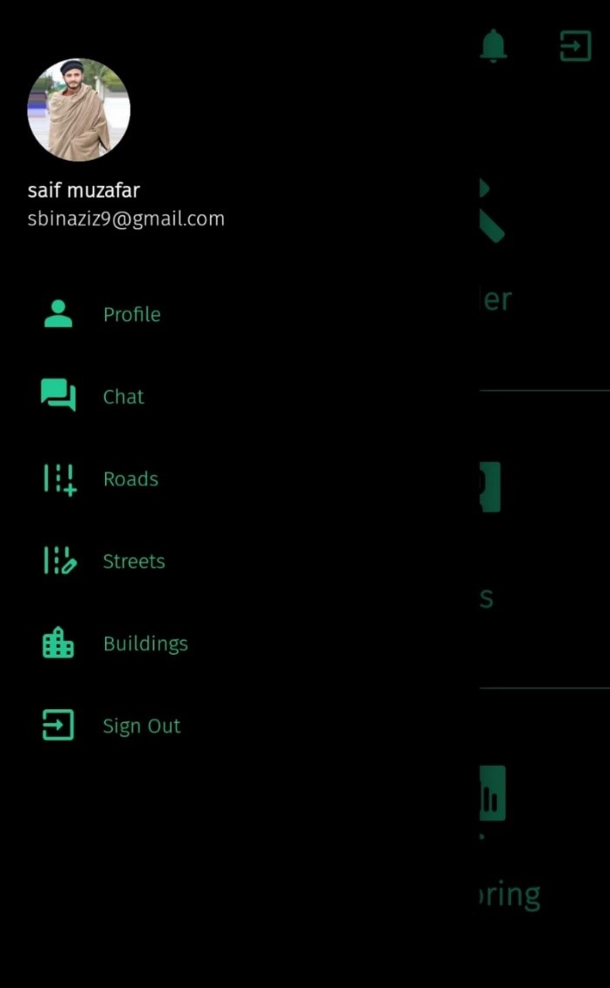
Navigation Bar

Slide 30
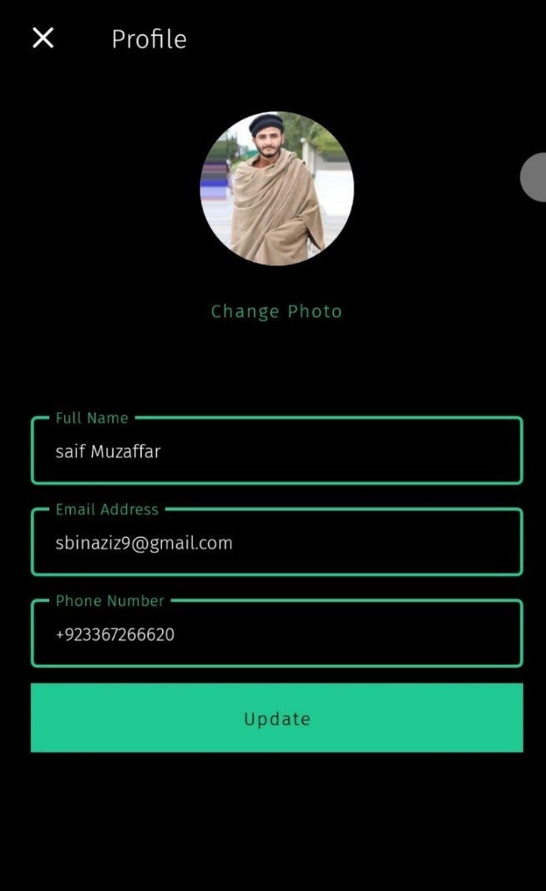
Profile

Slide 31
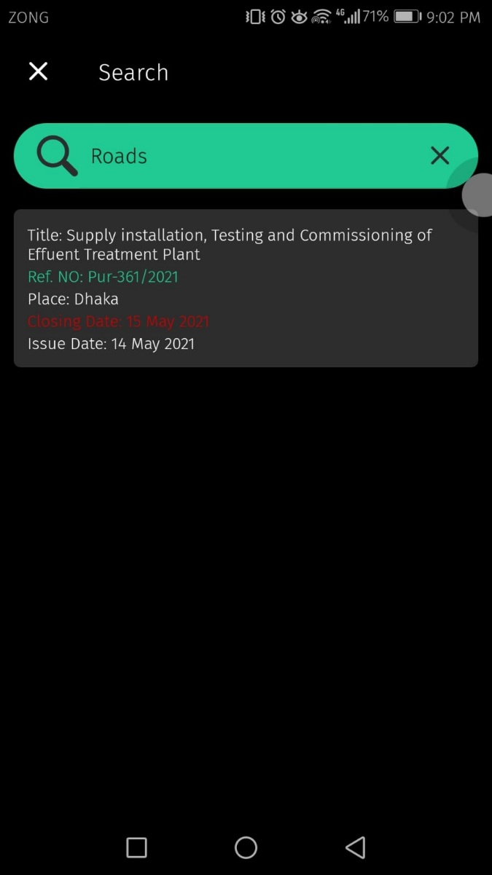
Search Tender

Slide 32
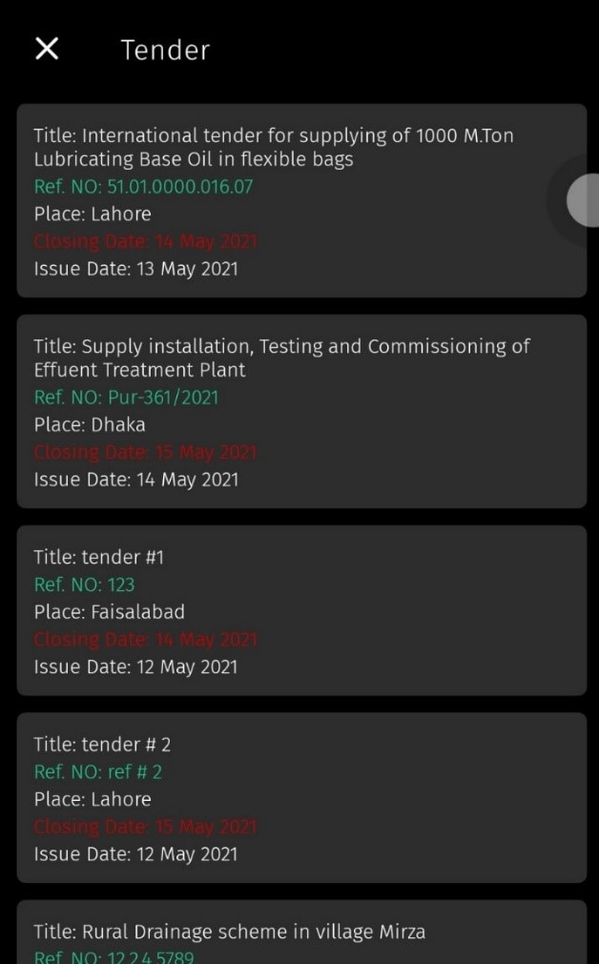
Tenders

Slide 33
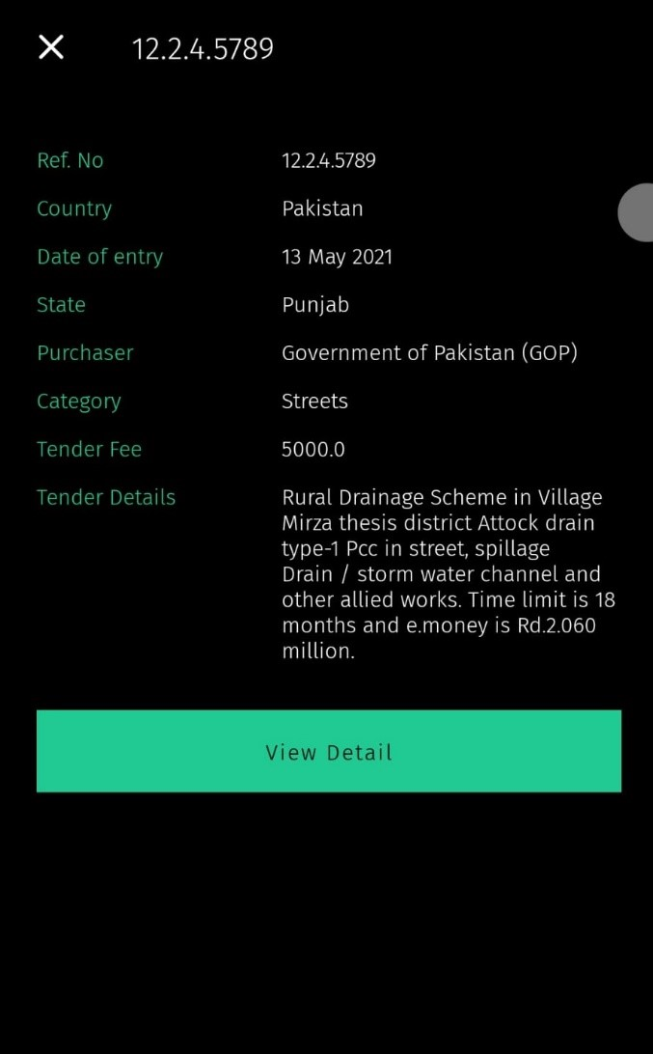
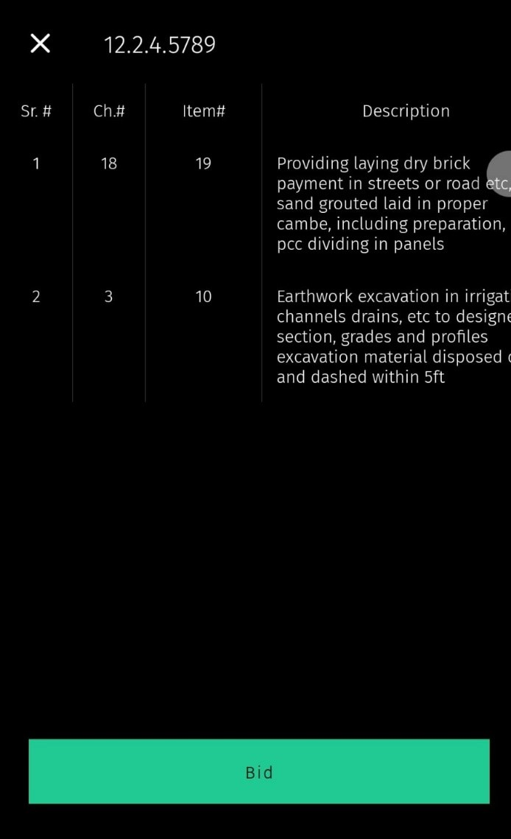
Tender Details

Slide 34
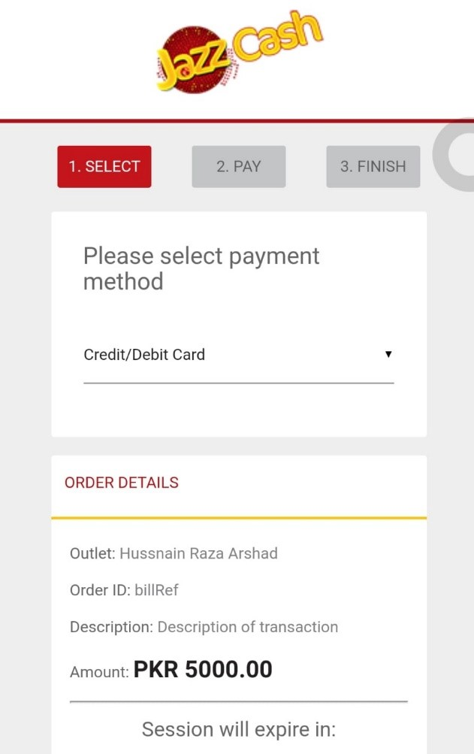
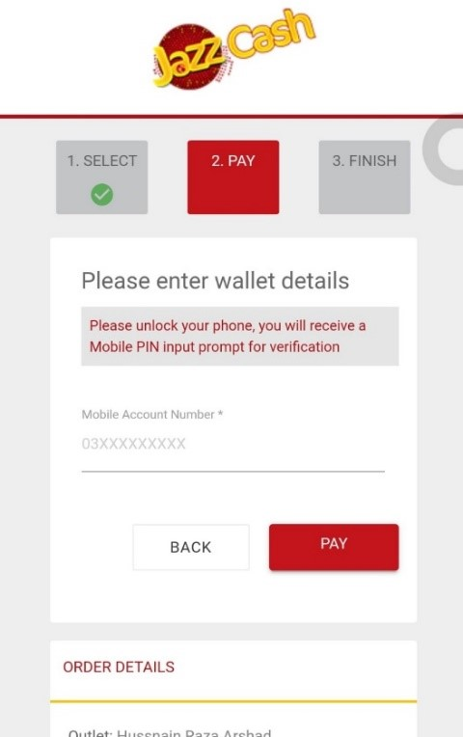
Pay Tender Fee

Slide 35
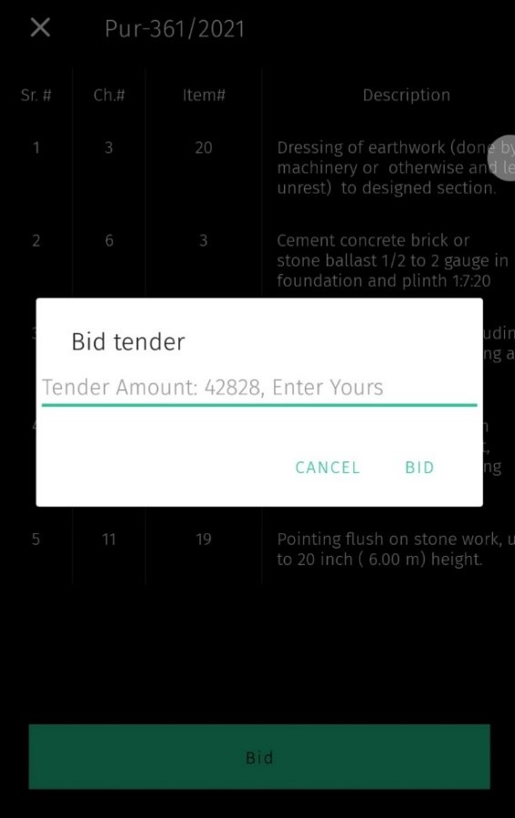
Bid On Tender

Slide 36
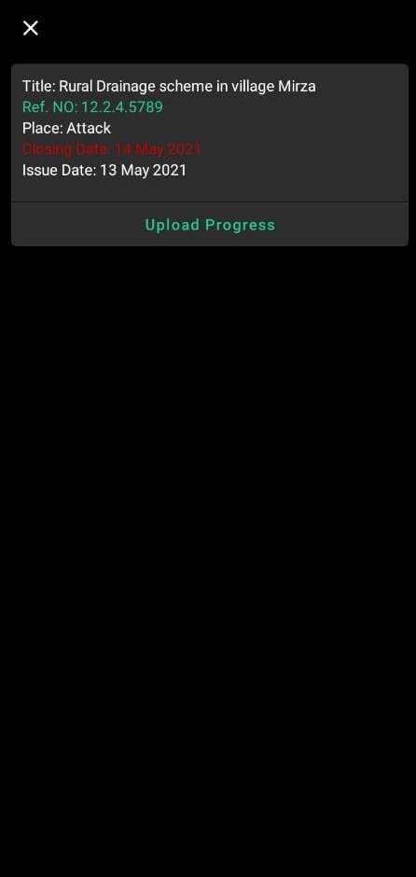
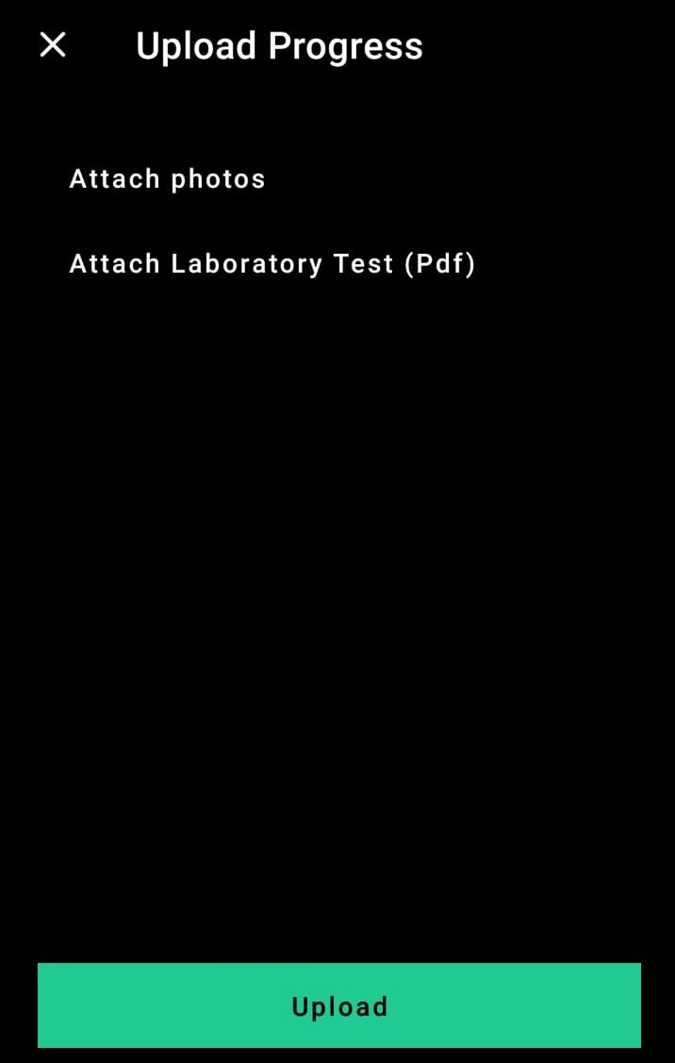
Monitoring

Slide 37
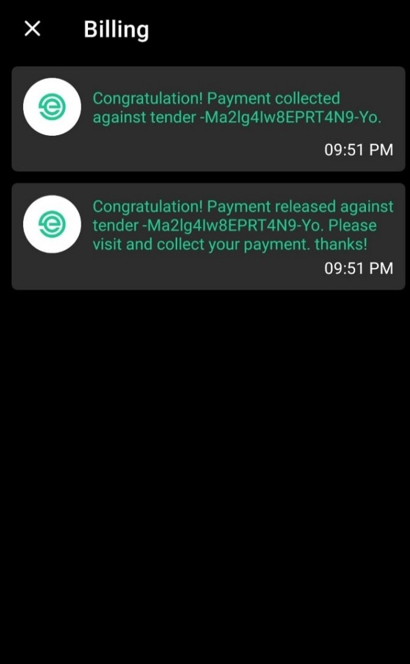
Billing

Slide 38

Work Done

Slide 39
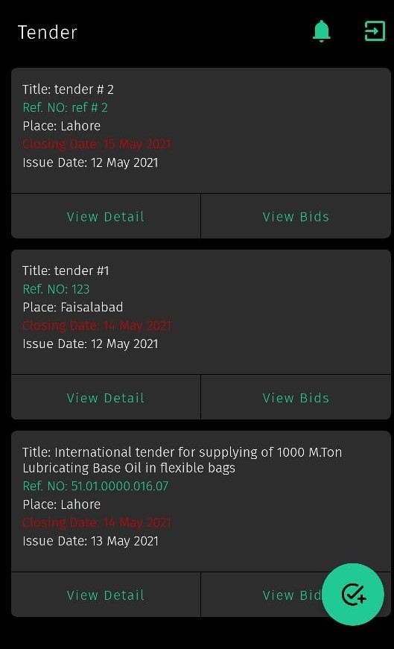
Tender Admin

Slide 40
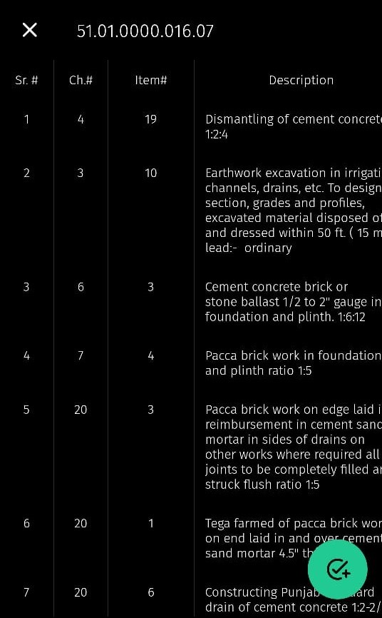
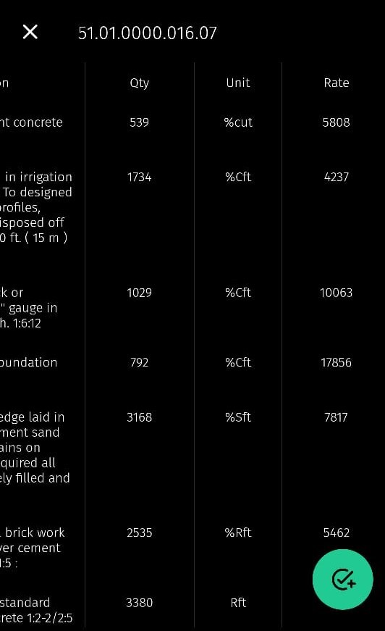
Bid Sheet

Slide 41
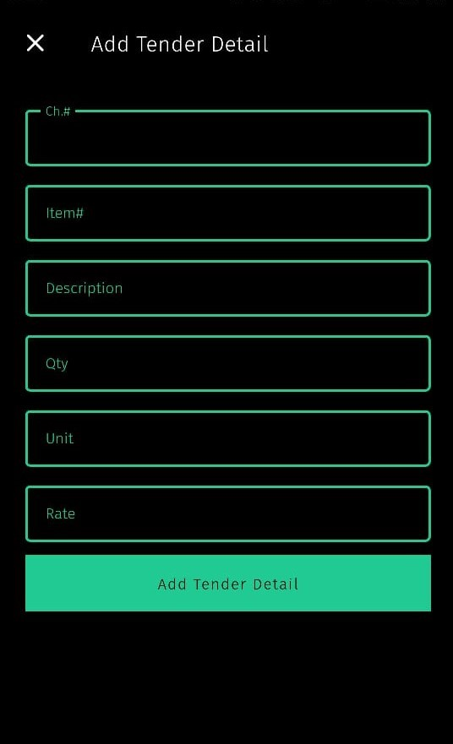
Tender Details

Slide 42
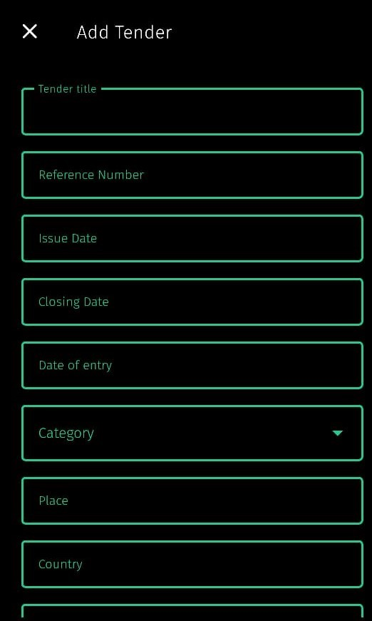
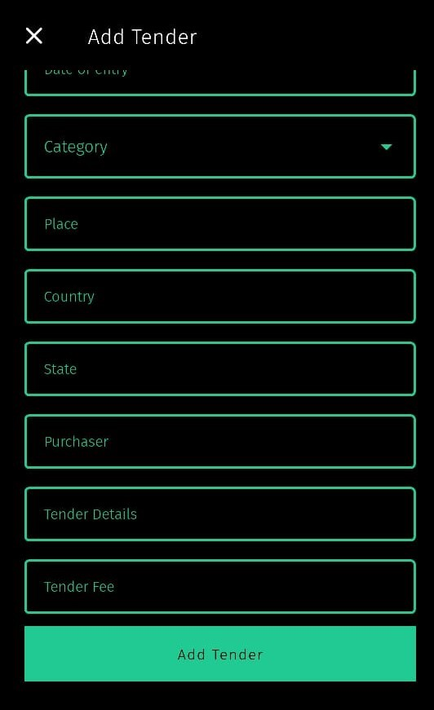
New Tender

Slide 43
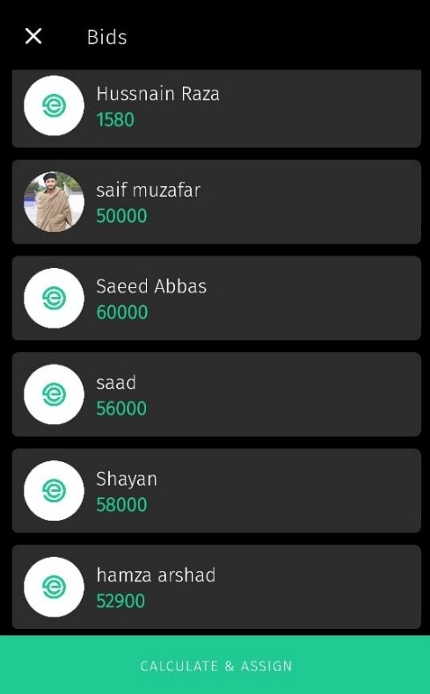
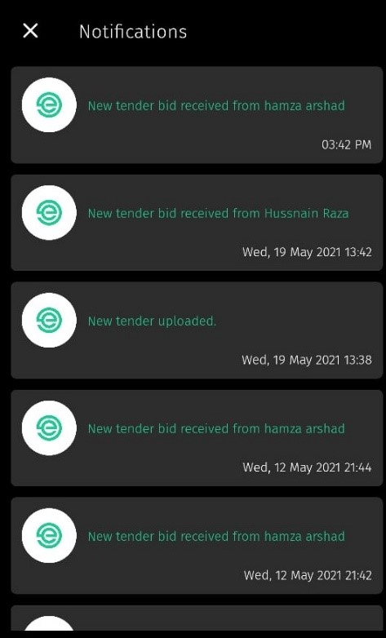
Bids And Notifications

Slide 44
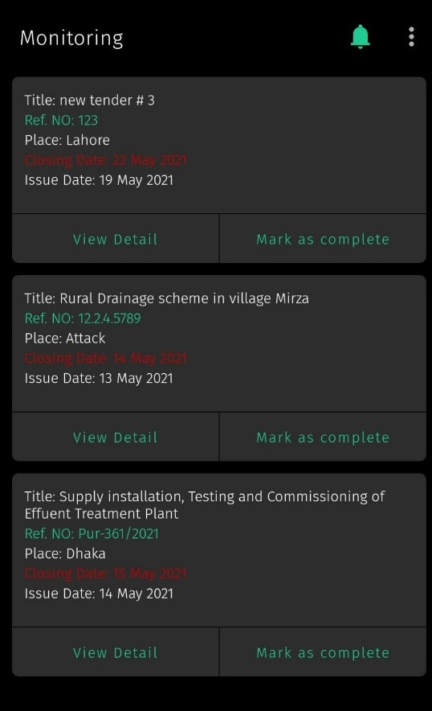

Monitoring Admin

Slide 45
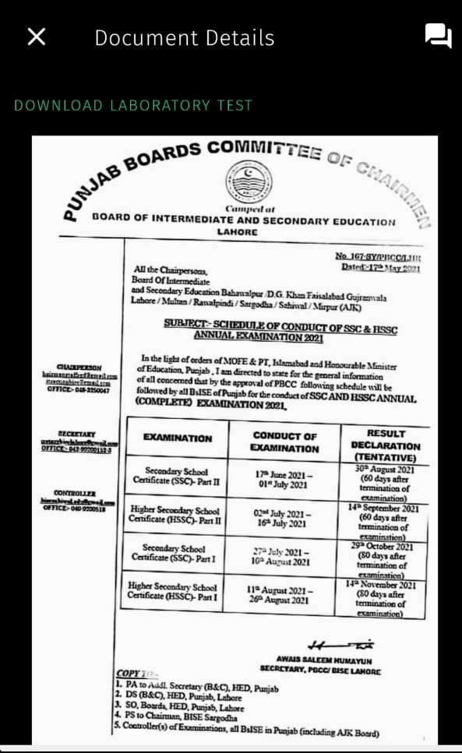
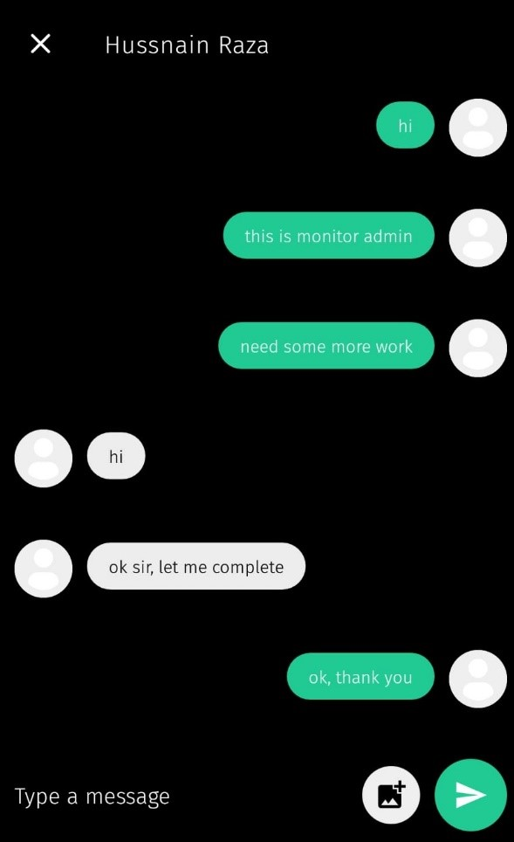
Monitoring Admin Details

Slide 46
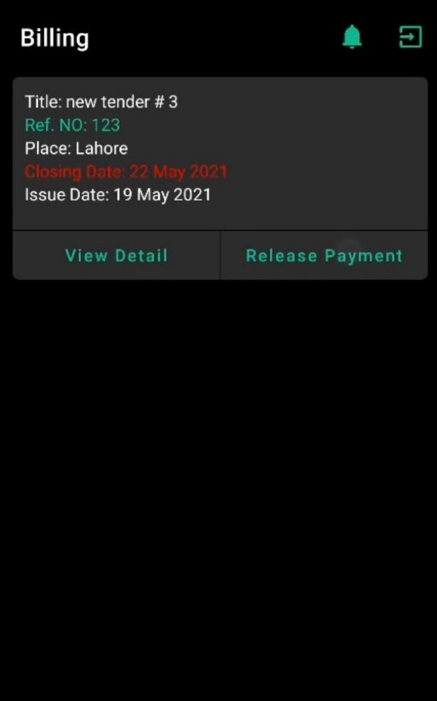
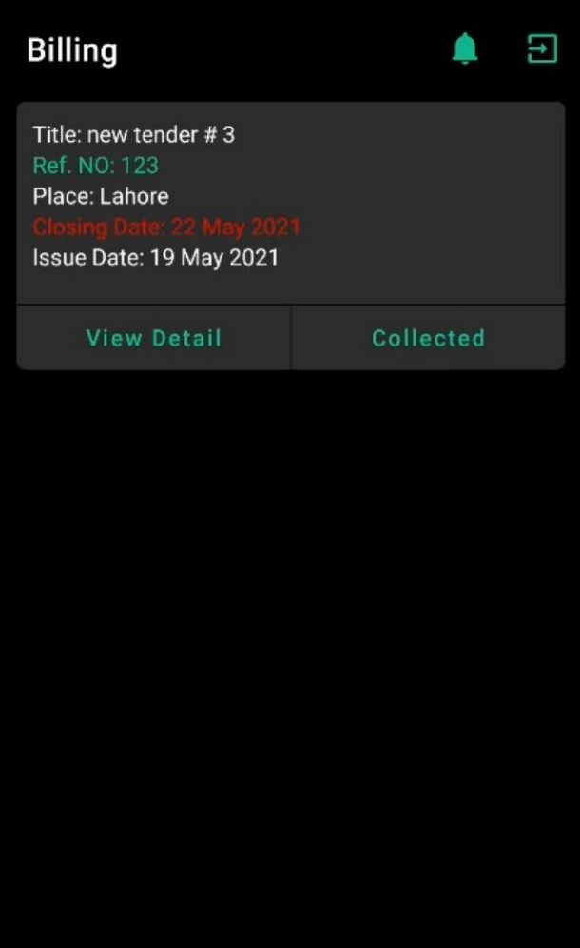
Billing Admin

Slide 47
References
https://www.google.com/search?q=submitted+to+higher+education+commission+pakistan&rlz=1C1CHBD_enPK921PK921&oq=submitted+to+higher+education+commission+pakistan&aqs=chrome..69i57.15562j1j7&sourceid=chrome&ie=UTF-8
https://www.javatpoint.com/
https://en.wikipedia.org/wiki/Main_Page
http://www.arabou.edu.sa/en/
www.youtube.com

Slide 48


Slide 49


